Slide 1
Communication Strategies for Vaccine Confidence:
Sharing Information Through
Social Media
WEEK 3
October 28, 2021
Notes:
Hello and welcome to Week 3 of NNCC’s Communication Strategies for Vaccine Confidence Learning Collaborative!
I’m Deepa Mankikar, Senior Project Manager at NNCC. I’m joined by Project Coordinator, Darlice Rocha and Monica Harmon, public health nurse, educator, researcher. We will be co-facilitating this session.
Last week, we focused on the power of storytelling and understanding your audience to craft your public health messaging. Today, we will examine best practices for social media and in particular for COVID-19 communications.

Slide 2
The National Nurse-Led Care Consortium (NNCC) is a non-profit membership organization that supports nurse-led care and nurses at the front lines of care.
NNCC supports comprehensive, community-based primary care and public health nursing through policy and advocacy, program development and management, technical assistance and support, and direct, nurse-led healthcare services.
Notes:
The National Nurse-Led Care Consortium is a nonprofit member-supported organization working to strengthen community health through quality, compassionate, and collaborative nurse-led care.
NNCC represents the intersection of nurse-led primary care and public health.
Our mission is to advance nurse-led health care through policy, consultation, and programs to reduce health disparities and meet people’s primary care and wellness needs.
NNCC is an affiliate of the Public Health Management Corporation.

Slide 3
COVID Vaccine Project Goals
Empower nurses with necessary information to engage care teams and communities about COVID-19 vaccines.
Provide learning opportunities to share up-to-date guidance, support peer engagement among nursing colleagues, and strengthen the nursing role.
Amplify the nursing voice by featuring nurse champions through our podcast and other media outlets.
Notes:
NNCC is partnering with the Centers for Disease Control and Prevention (CDC) to build COVID-19 vaccine confidence among nurses and the communities they serve.
Through this project, we aim to:
Empower nurses with the necessary information to engage with care teams and communities about COVID-19 vaccines;
Provide learning opportunities to share up-to-date guidance and support peer engagement among nursing colleagues; and
Amplify the nursing voice by featuring everyday nurse champions through our podcast and other media.
Please visit nurseledcare.org to learn more.

Slide 4
AGENDA
Check-In (5 minutes)
Didactic Presentation (20 minutes)
Discussion/Questions (10 minutes)
Break Out Activity (10 minutes)
Report Out (5 minutes)
Close & Debrief (10 minutes)
NNCC VACCINE CONFIDENCE TRAINING

Slide 5
TODAY’S LEARNING OBJECTIVES
Identify best practices for social media platforms.
Examine best practices for sharing your own content and engaging with others’.
Review use of NNCC’s campaign toolkit social media pack.
NNCC VACCINE CONFIDENCE TRAINING
Notes:
This week, learning series participants will become more familiar with social media best practices, as well as guidance for sharing content and engaging with others. We’ll also review NNCC’s campaign toolkit social media pack for resources that highlight the nursing voice.

Slide 6
SPEAKER
Sierra Isley Little (she/her/hers)
Communications Coordinator
National Nurse-Led Care Consortium
NNCC VACCINE CONFIDENCE TRAINING
Notes:
I’m excited to introduce today’s speaker, Sierra Isley Little, NNCC’s Communications Coordinator. Sierra runs NNCC’s social media accounts, creates informational graphics and publishes email-marketing campaigns. She is a recent graduate of Florida State University where she studied Editing, Writing and Media.
Welcome, Sierra! I’ll now pass it on over to you.

Slide 7
QUICK POLL
What social media platforms do you use (for professional and/or personal use)?
Facebook
LinkedIn
Twitter
Instagram
YouTube
TikTok
Other? Tell us in the chat!
NNCC VACCINE CONFIDENCE TRAINING
Notes:
Before we get started, let’s do a quick poll of this group’s current use of social media.

Slide 8
PLATFORMS
NNCC VACCINE CONFIDENCE TRAINING
Notes:
As Deepa discussed in her video recording, six of the most popular social media platforms include:
Facebook
Instagram
LinkedIn
YouTube
Twitter
And TikTok
Let’s go into more detail about which platform is the most appropriate for your message or post.

Slide 9
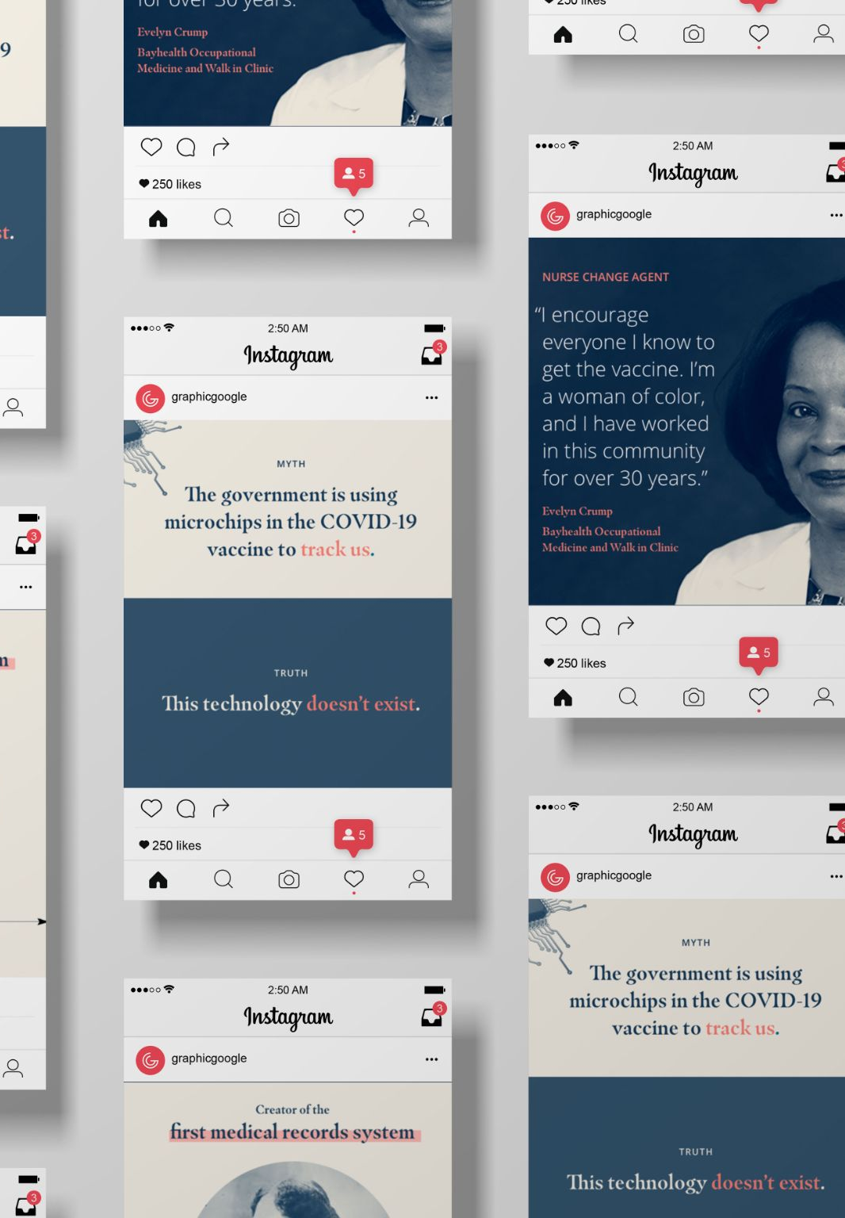
VISUAL PLATFORMS
NNCC VACCINE CONFIDENCE TRAINING
Notes:
Now, let’s get into some social media best practices.

Slide 10
VISUAL PLATFORMS: INSTAGRAM
Instagram posts are pictures with captions.
Don’t stress about sharing “perfect” photos
Graphics, like this one, are useful for sharing information visually
Some resources to make your own graphics: Canva.com (free and easy), Adobe Photoshop, InDesign…OR our premade graphics!
You can choose to turn comments off or on
NNCC VACCINE CONFIDENCE TRAINING
Notes:
Instagram posts are photos with captions. You can also share short videos on Instagram, but I would recommend TikTok or YouTube – more on that later.
Instagram can be intimidating for those of us who aren’t self-proclaimed photographers. The key to posting on Instagram is not to stress about sharing something perfect! If you have a picture as simple as you smiling with a mask on, share it. Instagram users will look to your caption for information and resources.
Another great way to use Instagram to share information is by posting graphics, like this CDC graphic pictured. I like this example because the image is readable, the caption links to a resource (vaccines.gov) and they used relevant hashtags.
Some programs that I recommend to make graphics include Canva (easy and free), Adobe Photoshop or Adobe InDesign. NNCC actually has a social media pack of graphics that are already sized perfectly for Instagram! So, if you don’t feel like making one but you want to share important COVID-19 information, check out our toolkit on our website.
I wanted to point out the comments on this post. I screenshotted this directly from them, and when I scrolled down, I saw a bunch of comments sharing misinformation about the vaccine. We are going to have a full training about combating misinformation next week, so please attend if you’re interested in learning more, but my basic recommendation is that fighting with strangers is not always going to be the most productive use of your time. If you find yourself being inundated with hate comments, you can turn off comments within Instagram. If you do notice a genuine question and you feel comfortable replying, you can reply to that person and choose to discuss their question publicly or privately through DM. We’ll discuss these strategies in a few minutes.

Slide 11
VISUAL PLATFORMS: YOUTUBE & TIKTOK
Best platform to share short-form videos (up to three minutes, but most are shorter)
Useful for reaching younger demographic
Can use previously made sounds or prompts
Built-in video editor within the app
Can be complicated
Best platform to share long-form videos
All demographics
Probably going to be your least-used social media platform, but YouTube videos are easy to share on other platforms like Twitter.
NNCC VACCINE CONFIDENCE TRAINING
Notes:
TikTok is the best social media platform to share short form videos. You can upload videos up to three minutes long, but I would recommend sticking under 60 seconds.
TikTok is going to be one of the most effective platforms for reaching young people – but it also takes a lot of effort and some video production skills.
One great thing about TikTok is that you can use audio created by other users. So, if something is trending, you can record your own version of it. There’s also a video editor built into the app which means you don’t need to have video experience to make something great, but it does take patience. It’s not super intuitive.
I would only recommend using TikTok if you feel confident showing yourself/talking on camera. It could be a great way to share your COVID vaccine story!
YouTube is for long form video content. So, if you have something like an interview with a nurse, an animation, or a webinar recording, you may want to consider posting it on YouTube. This is probably the least relevant to us since I don’t think any of us are filmmakers, but it can be a good social media platform to browse content or share other creator’s content.

Slide 12
OTHER PLATFORMS
NNCC VACCINE CONFIDENCE TRAINING
Notes:
Now, let’s get into some social media best practices.

Slide 13
FACEBOOK & TWITTER
If you’re sharing content from your personal Facebook account, it will reach your friends.
Sharing from a company page or posting in a group reaches a wider audience
You can share text posts, photos, videos and links
Best to share once or twice a day
Best platform to use if you’re looking to connect with other nurses or professionals
Most often used to share job opportunities, webinar information, etc.
Best to stick to text or photos
NNCC VACCINE CONFIDENCE TRAINING
Notes:
If you want to share a post on your personal Facebook feed, it will reach your Facebook friends. That’s important to keep in mind when you’re sharing information about vaccines, public health, etc, because your grandma, crazy uncle, child, etc can see what you are sharing. Be prepared to respond to comments and discuss your personal story – more on that in a few.
If you’re posting from a company page, you’ll reach anyone who follows that page or stumbles on it. You can also join groups via your personal account – like groups of nurses in your area, neighborhood groups, etc. That can be a useful tool for connecting with other nurses.
Facebook is versatile because you can share text posts, photos, videos or links. There’s no limit to how much you can type, but keep in mind it’s always best to go short and sweet. You don’t want to spam people by sharing constantly; Twitter is a more appropriate platform for hourly updates.
LinkedIn is great for connecting with nurses or other health care professionals. You’ll notice that most people “post” on LinkedIn to share job or personal updates related to their professional career. I would stick to only sharing professional posts on LinkedIn, and know that most people are not going to LinkedIn for photo or video updates.

Slide 14
TWITTER
Great for sharing frequent updates
You can post text, photos or videos, but text must stay under a 280 character limit (about 2-3 sentences)
#Hashtags and trends are important to follow
You can reply and react to other tweets. Liking a tweet shows your support while retweeting shares that tweet to your own followers. This can be useful for sharing information from bigger accounts.
NNCC VACCINE CONFIDENCE TRAINING
Notes:
Twitter is the best platform for frequent updates; however, you will always need to stay under a 280 character limit. Sometimes you’ll need to get creative to fit information into one tweet. I recommend abbreviations and only included the most essential information – you can always link to a page with more information.
You should use relevant hashtags. For example, if you’re sharing something related to COVID-19, you can hashtag #COVID19 so that anyone scrolling through that hashtag will see your tweet. You can also look at what’s trending (aka, phrases or hashtags that are most popular during that current moment)
Twitter is very interactive. You can reply to a tweet that you see on your feed, like a tweet or retweet a tweet. Liking someone’s tweet notifies them that you’ve liked it – and your likes are public to your followers. Retweeting someone makes their tweet show up on your Twitter feed, meaning that your followers can also see it. I like to retweet big accounts like the CDC when they share an important update about COVID.
In this example, I quoted a line from a Kaiser Family Foundation article and posted a link to the article. I also tagged @KFF which is the Kaiser Family Foundation. Make sure to tag accounts when relevant because if they retweet you, they are sharing your content with all of their followers, which in turn will get you more followers!

Slide 15
THE IMPORTANCE OF SHARING INFORMATION
Educate, Don’t Dictate: Many populations are receiving incorrect information from trusted sources. Help them to see that people can have their best interests at heart and still share incorrect information. Avoid diminishing their communities and leaders.
Meet People Where They Are: Different populations are focused on different pieces of misinformation. Try to understand where your community is coming from and what matters most to them. Share information that is aligned with their needs.
Make it a Conversation: Most individuals aren’t interested in being told what they’re doing wrong. Sharing information in a collaborative, 2-way dialogue can help make your community open to receiving new information.
Prioritize Your Mental Health: If the conversation is going nowhere or you feel unsafe, you should stop engaging.
NNCC VACCINE CONFIDENCE TRAINING
Notes:
There is a lot of misinformation circulating around COVID-19 and the vaccine. As a trusted and knowledgeable resource, nurses have a unique opportunity to combat misinformation and share crucial facts that can help communities to feel more comfortable getting the vaccine.
Here are a few things to consider when sharing information:
Educate, Don’t Dictate: Many populations are receiving incorrect information from trusted sources. Help them to see that people can have their best interests at heart and still share incorrect information.
Meet People Where They Are: Try to understand where your community is coming from and what matters most to them. Share information that is aligned with their needs.
Make it a Conversation: Most individuals aren’t interested in being told what they’re doing wrong. Sharing information in a collaborative, 2-way dialogue makes for a more productive conversation.
Prioritize your mental health: Posting on social media can be really taxing, especially when you’re discussing topics like vaccines and COVID. It can sometimes make you angry or upset. If you notice that you feel uncomfortable using social media, take a step back. You do not need to interact with somebody who is being rude or hostile. You can also choose to block someone if they are speaking inappropriately or making you feel uncomfortable. Always be careful not to reveal important information about yourself online (your address, location of employment, etc)

Slide 16
SOCIAL MEDIA BEST PRACTICES
Be sure that anything posted to socials is backed by credible research
Encourage social media users to consult their primary care providers before making any changes to their medications, diets, exercise plans, or medical routines.
Help educate the community and patients through sharing useful and trustworthy articles
Ask questions - encourage your followers to share their experiences
Think about the purpose of each post - what are you trying to get your audience to do
Use hashtags to connect your posts to the overall campaign: #nursesmakechangehappen
NNCC VACCINE CONFIDENCE TRAINING
Notes:
Social media can help you share information with the larger community and create an open space for question. Here are some best practices to get you started!

Slide 17
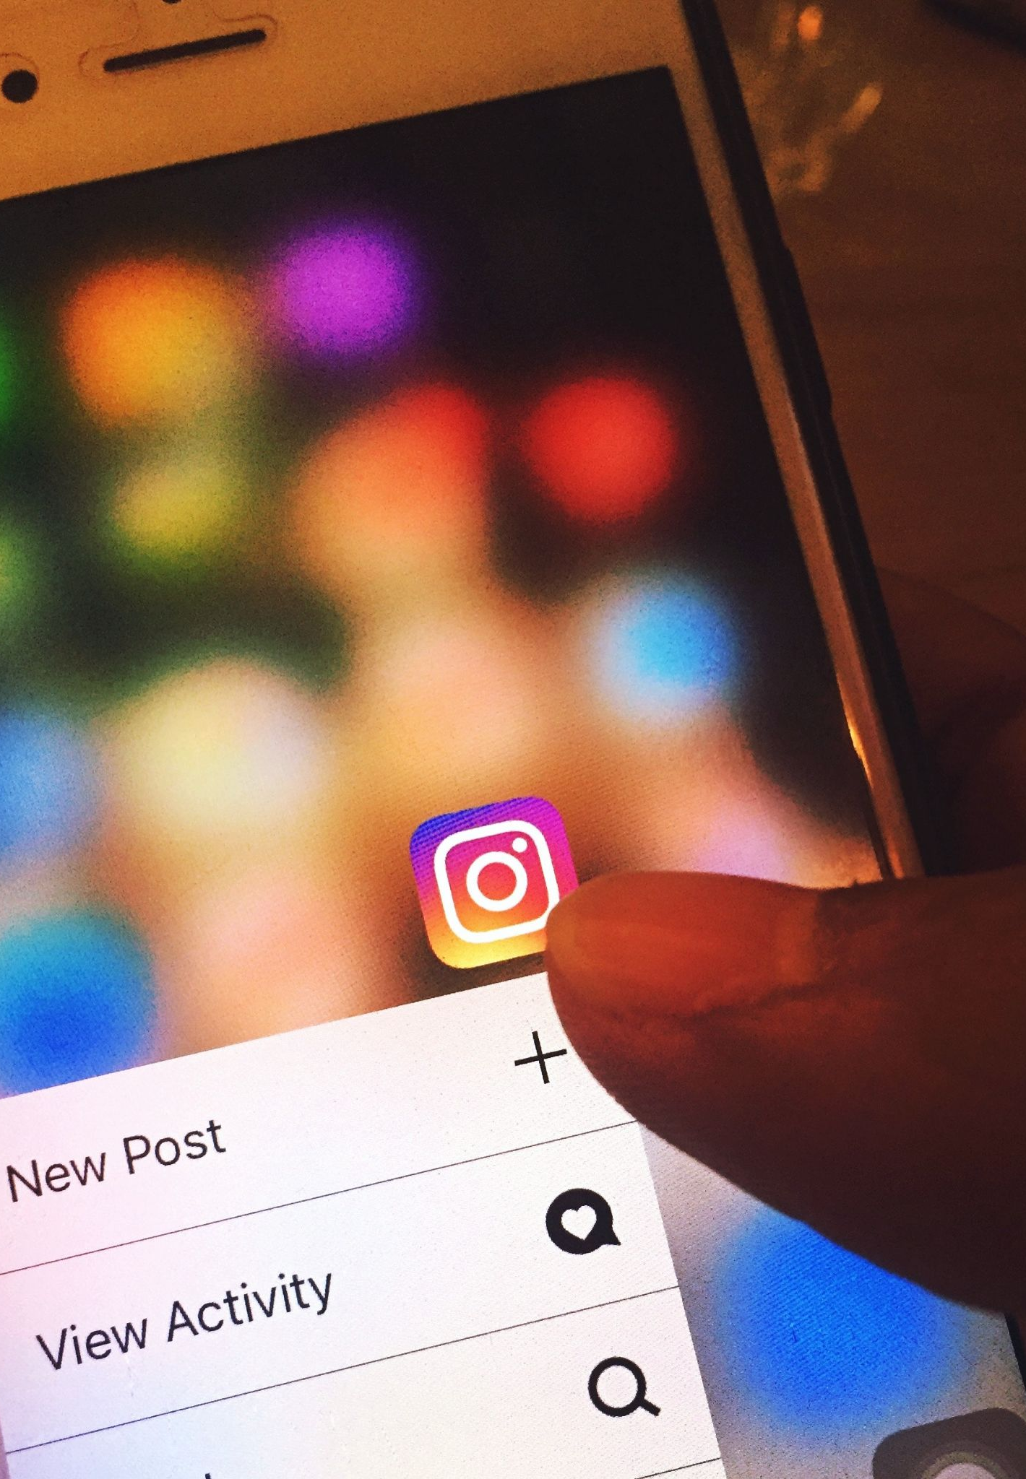
SOCIAL MEDIA RESOURCES
NNCC VACCINE CONFIDENCE TRAINING

Slide 18
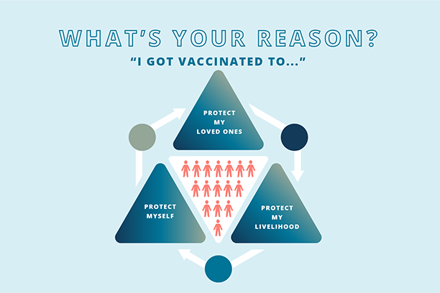
TOOLS TO HELP YOU SHARE INFORMATION
Guide to Sharing Your Story This downloadable PDF will guide you through the creation of your story - complete with examples and a how-to guide.
Social Media Pack These templates and guide will help you to share your story and factual information with others, specifically on social media!
Check out: nurseledcare.org/toolkit
NNCC VACCINE CONFIDENCE TRAINING
Notes:
Our Nurses Toolkit includes a number of tools that can help you craft and share your story and share information:
In our toolkit, you’ll find
Elements to help you share your story
Historical nurse milestones
Strategies to correct misinformation
Check out our downloadable PDF “Guide to Sharing Your Story” and the accompanying social media pack as a place to start.
You can share these graphics instead of making your own!

Slide 19
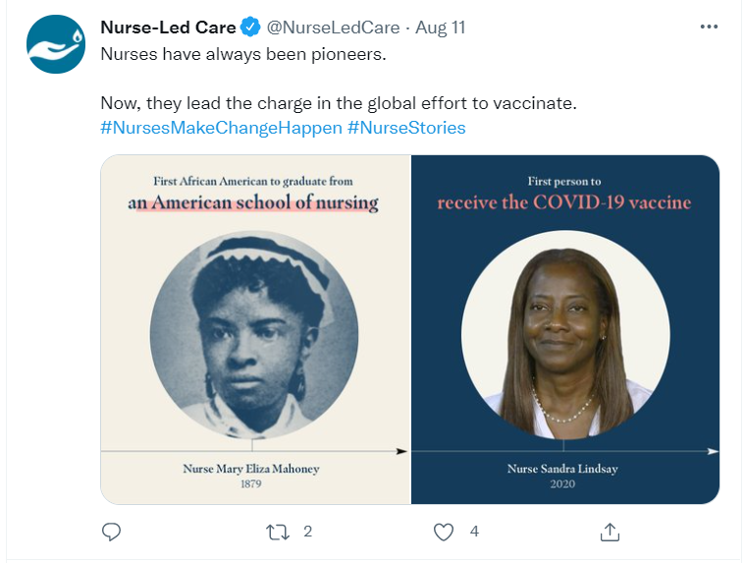
Notes:
The next few slides are examples of social media posts from our campaign.
When speaking with our Vaccine Confidence Advisory Committee of 20 nurses around the country, they really wanted to make this campaign stand out through our messaging and our opportunity to amplify the nursing voice.
In our #NursesMakeChangeHappen campaign, we highlight the achievements of historic nurses and also applaud the nurses of today. We recognize the different roles and spaces where nurses make a difference and have that message woven throughout our imagery and posts.
In this post on Twitter, we highlight Nurse Mary Eliza Mahoney, first African American graduate from an American school of nursing in 1879. She is next to Nurse Sandra Lindsay, first person to receive the COVID-19 vaccine in 2020.
A post like this could be recreated through a graphic design program like Canva. You could also simply share a picture or selfie to go along with a caption. We kept our caption short on this post since most of the information was contained in the photograph. Since we used the hashtag #NursesMakeChangeHappen, anyone searching that hashtag will be able to interact with this post. If you don’t feel comfortable posting your own Twitter content, you can just retweet/like posts that you want to support!

Slide 20
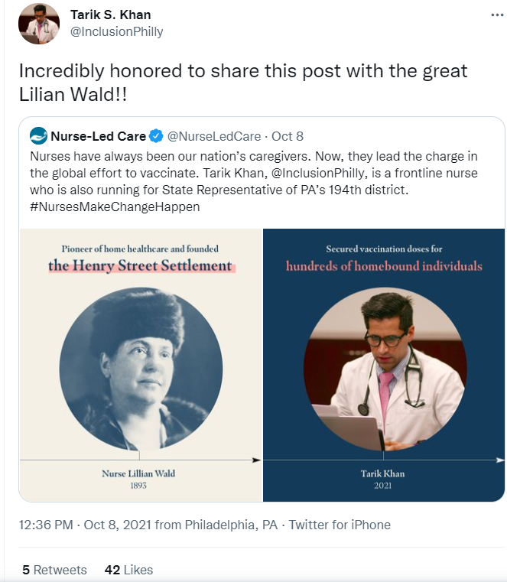
Notes:
Here we see another example of a Twitter post from NNCC’s campaign.
This post highlights Nurse Lillian Wald, a pioneer of home healthcare and founder of the Henry Street Settlement in New York City. She is next to Nurse Tarik Khan, a frontline nurse in Philadelphia. Tarik has played an essential role in our city for building up a homebound vaccination program and securing vaccination doses for hundreds of homebound individuals.
You can see that Tarik retweeted this post; therefore, it was shared with all of his followers. This was our top performing post because of that! If you’re highlighting someone else’s work, make sure to tag them like we tagged Tarik so if they see it, they can share with their own network.

Slide 21
Notes:
Here is an example of a Facebook post that provides vaccine facts about the COVID-19 vaccine and fertility. I got a lot of comments on this post when it was shared – some supported us, and some disagreed and cited misinformation. We will go into further detail about how to respond to comments like that in next week’s session. But, as I mentioned earlier, always make sure that what you are sharing is backed by credible research so you can provide a resource should somebody ask.

Slide 22
Notes:
Here’s a LinkedIn post example. This is for a webinar that NNCC is hosting next week. Although we usually include graphics for our webinar, they are not necessary for a LinkedIn post. I included information about what the webinar is about, the date, and a registration link so followers can take action. This is a post related to professional development which is why I chose to share on LinkedIn.

Slide 23
BREAK OUT GROUPS
Social Media Messaging
NNCC VACCINE CONFIDENCE TRAINING

Slide 24
REPORT OUT
NNCC VACCINE CONFIDENCE TRAINING

Slide 25
QUESTIONS?
NNCC VACCINE CONFIDENCE TRAINING

Slide 26
ADDITIONAL RESOURCES
Centers for Disease Control and Prevention
CDC Social Media Tools, Guidelines & Best Practices
CDC Social Media Tools
CDC Social Media Toolkit: COVID-19 Vaccinations
Public Health Communications Collaborative
Daily Downloads (ready-to-use social media graphics)
Messaging Resources (talking points, infographics, and toolkits for COVID-19 communications)
NNCC VACCINE CONFIDENCE TRAINING
Notes:
Here are some additional great resources to check out.

Slide 27
We want to hear your stories! @NurseLedCare #NursesMakeChangeHappen
Notes:
If you are a nurse or health care professional and you feel comfortable sharing your story online, know that we want to hear it! Tag us or use the hashtag #NursesMakeChangeHappen so we can share and support your post.

Slide 28
Please submit questions through this Google Form. We will address them during the live session on November 4th .
Notes:
Please submit any questions you have using this Google Form. This link will also be found in your emails from NNCC.
We will address questions during the live session on November 4th

Slide 29
Notes:
Thank you for tuning in to this session. Please complete the post-session quiz to receive CE credits. The link to the quiz will be available in the Google Drive Folder. We’ll also include it in our follow-up email.
Join us next week, where we will hear from nurse Letha Joseph on strategies to confront misinformation.
This concludes today’s session!

